Slide 1

A/B Testing
CatchZeng 2021.07.14

Slide 2
Contents
What is A/B(A/B/n) testing?
Why consider A/B testing?
What can you A/B test?
What are the different types of A/B testing?
How to Perform an A/B Test?
Compare
Demo
Key points
Reference

Slide 3
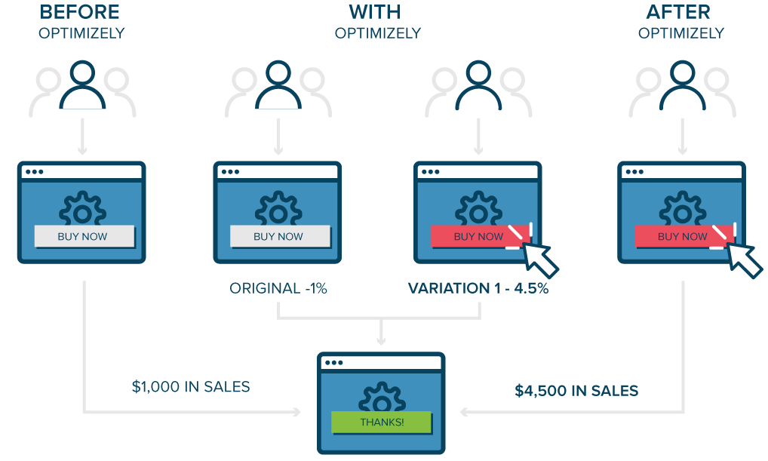
What is A/B testing?
A/B testing (also known as split-run testing) is a user experience research methodology.
A/B testing consist of a randomized experiment with two variants of a single variable, A and B, are shown to different segments of website visitors at the same time to determine which version leaves the maximum impact and drive business metrics.
Notes:
is a user experience research methodology
random
variant
at the same time

Slide 4
Why consider A/B testing?
Solve visitor pain points
Get better ROI from existing traffic
Reduce bounce rate
Make low-risk modifications
Achieve statistically significant improvements
Redesign website to increase future business gains
Notes:
Can't find the buy now button
The cost of acquiring traffic is too high
Test multiple variations of website elements until you find the best version. This can not only help you find friction and visitor pain points, but also help improve the overall experience of your website visitors, allowing them to spend more time on your website and even convert them into paying customers.
Small incremental changes reduce risk; resources are positioned as the largest output with the fewest modifications, thereby increasing the return on investment. Common examples: modify product description, add new features
A/B testing is completely data-driven, there is no room for guessing, intuition, and you can make better decisions.
Fast forward in small steps and continuously optimize the website (agile thinking)

Slide 5
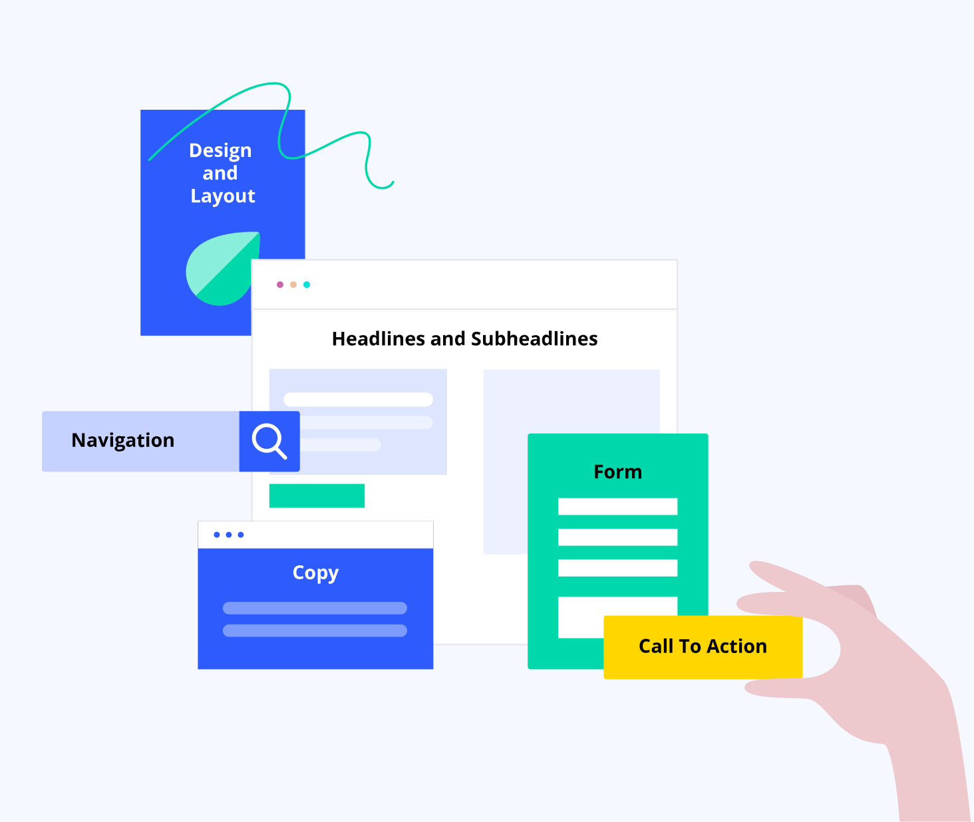
What can you A/B test?
key site elements
Notes:
Copy
Design and Layout
Navigation
Form
CTA
It’s worth mentioning that there are now many AI automatically generated (color, style, text, speech emotions, etc.) different variants for experimentation.

Slide 6
What are the different types of A/B testing?
A/B testing（Split-run testing)
Multivariate testing
Split URL testing
Multipage testing（Google Optimize not yet available）
Banner(temporarily) testing
Personalization testing
Notes:
A/B testing is a general term, which defines the basic concept of control and change experiment process. Ideally, there are multiple types of testing methods-A/B testing (or split testing), split URL testing, multivariate testing, multipage testing, banner testing and personalization testing.
A/B testing allows you to test simple page elements, while on the other hand, multivariate testing allows you to simultaneously test various elements using the concepts of permutation and combination. At the same time, Split URL testing allows you to test new designs of existing pages, while multi-page testing enables you to implement a single change on multiple pages at the same time, saving time, money and effort.

Slide 7
A/B testing（Split-run testing)
Notes:
Variation A is the original version.
Variations B to n each contain one or more elements modified from the original element (for example, different colored call-to-action buttons)

Slide 8
Multivariate testing
Notes:
Two titles (original "H1" and variant "H2") and three hero images (original "A" and variants "B" and "C"), resulting in 6 combinations;
Emphasize the combination and analyze the best match between multiple elements;
Reduce the need for multiple A/B tests and improve efficiency;

Slide 9
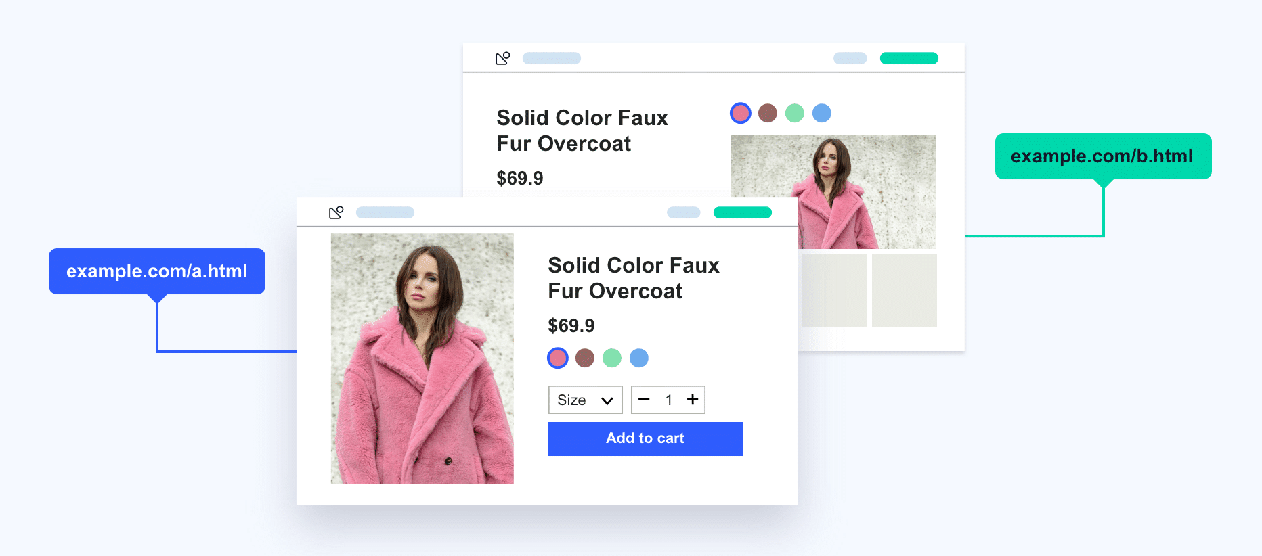
Split URL testing
Notes:
It is very suitable to try new designs while using existing page designs for comparative analysis.
It is recommended to run tests for non-UI changes, such as switching to a different database, optimizing page load time, etc.
Change the web workflow. Workflow can greatly affect business transformation, helping to test new paths before implementing changes and determine if any sticking points are missed.
A better and highly recommended method for testing dynamic content.

Slide 10

Multipage testing
Notes:
It enables you to create a consistent experience for your target audience.
It can help your target audience see a consistent set of pages, whether it's a control or a variation of it.
It enables you to implement the same changes on multiple pages to ensure that your website visitors will not be distracted and bounce between different variants and designs while browsing your website.
Emphasize the interaction and influence between pages

Slide 11
Banner(temporarily) testing
Notes:
Quickly add a banner message.
I prefer to call it a temporary test
For example, if your restaurant closes the restaurant and switches to takeout and delivery, you can notify customers.
Or, there is an event that lasts for a period of time, so use the banner test, set the experiment time, you don't need to manually remove the event notification.

Slide 12
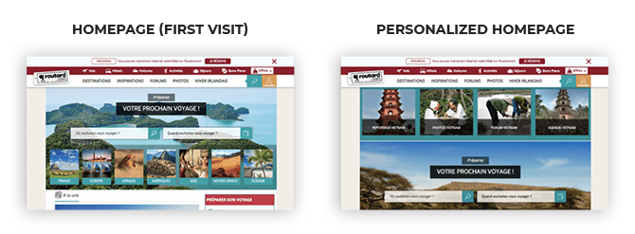
Personalization testing
Notes:
Unlike other experiments, personalization can run forever and there are no variations. They are a set of changes provided to anyone who meets the targeting criteria.

Slide 13
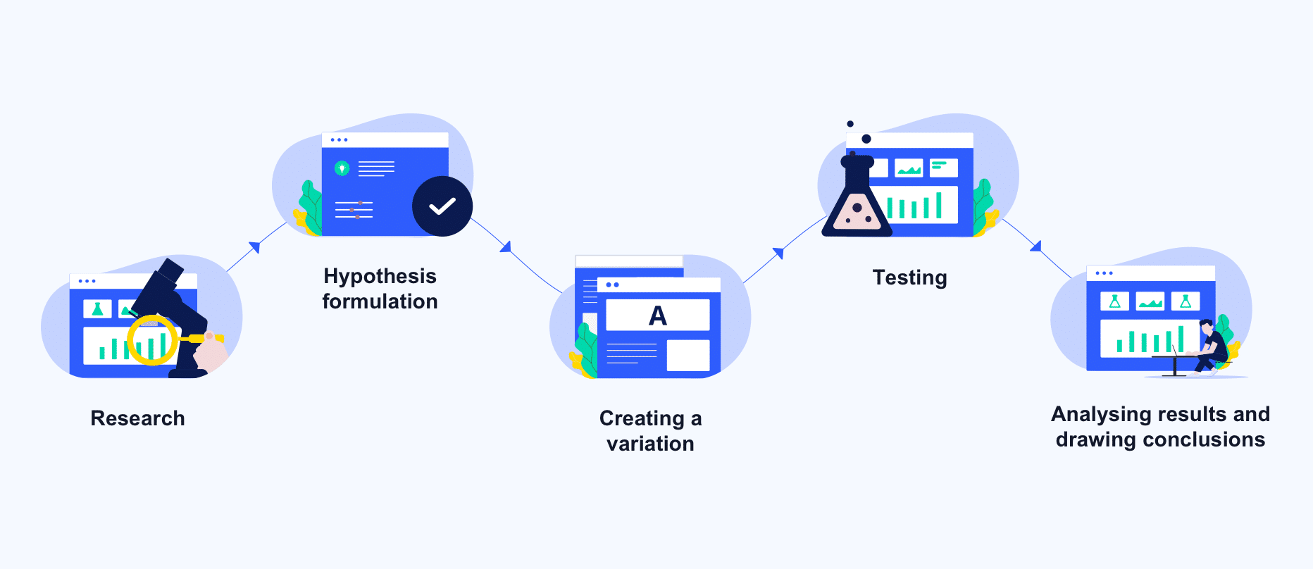
How to Perform an A/B Test?
Conduct thorough research
Observe and formulate a hypothesis
Create the necessary variation(s)
Run the test
Analyse results and deploy changes
Notes:
Research: Quantitative website analysis tools; make actionable observations for the next steps.
Put forward hypotheses: analyze and understand these data, draw website and user portraits to formulate hypotheses supported by data.
Variation: Enough people don't fill out the form? Does your form have too many fields? Will it ask for personal information? Maybe you can try the shorter form variant or other variants by omitting the fields that ask for personal information
Test: Start the test and wait the specified time to obtain statistically significant results. Calculating test time tool https://vwo.com/tools/ab-test-duration-calculator/
Analyze and deploy changes:
Conceptually, A/B testing seems to be a simple experimental process. However, it is not. This is a complicated process that requires patience, persistence and precision. Running A/B testing involves five main phases and multiple phases. The more thorough your research, plans, and hypotheses are developed, the better the tests you create and the greater the chance of winning.

Slide 14
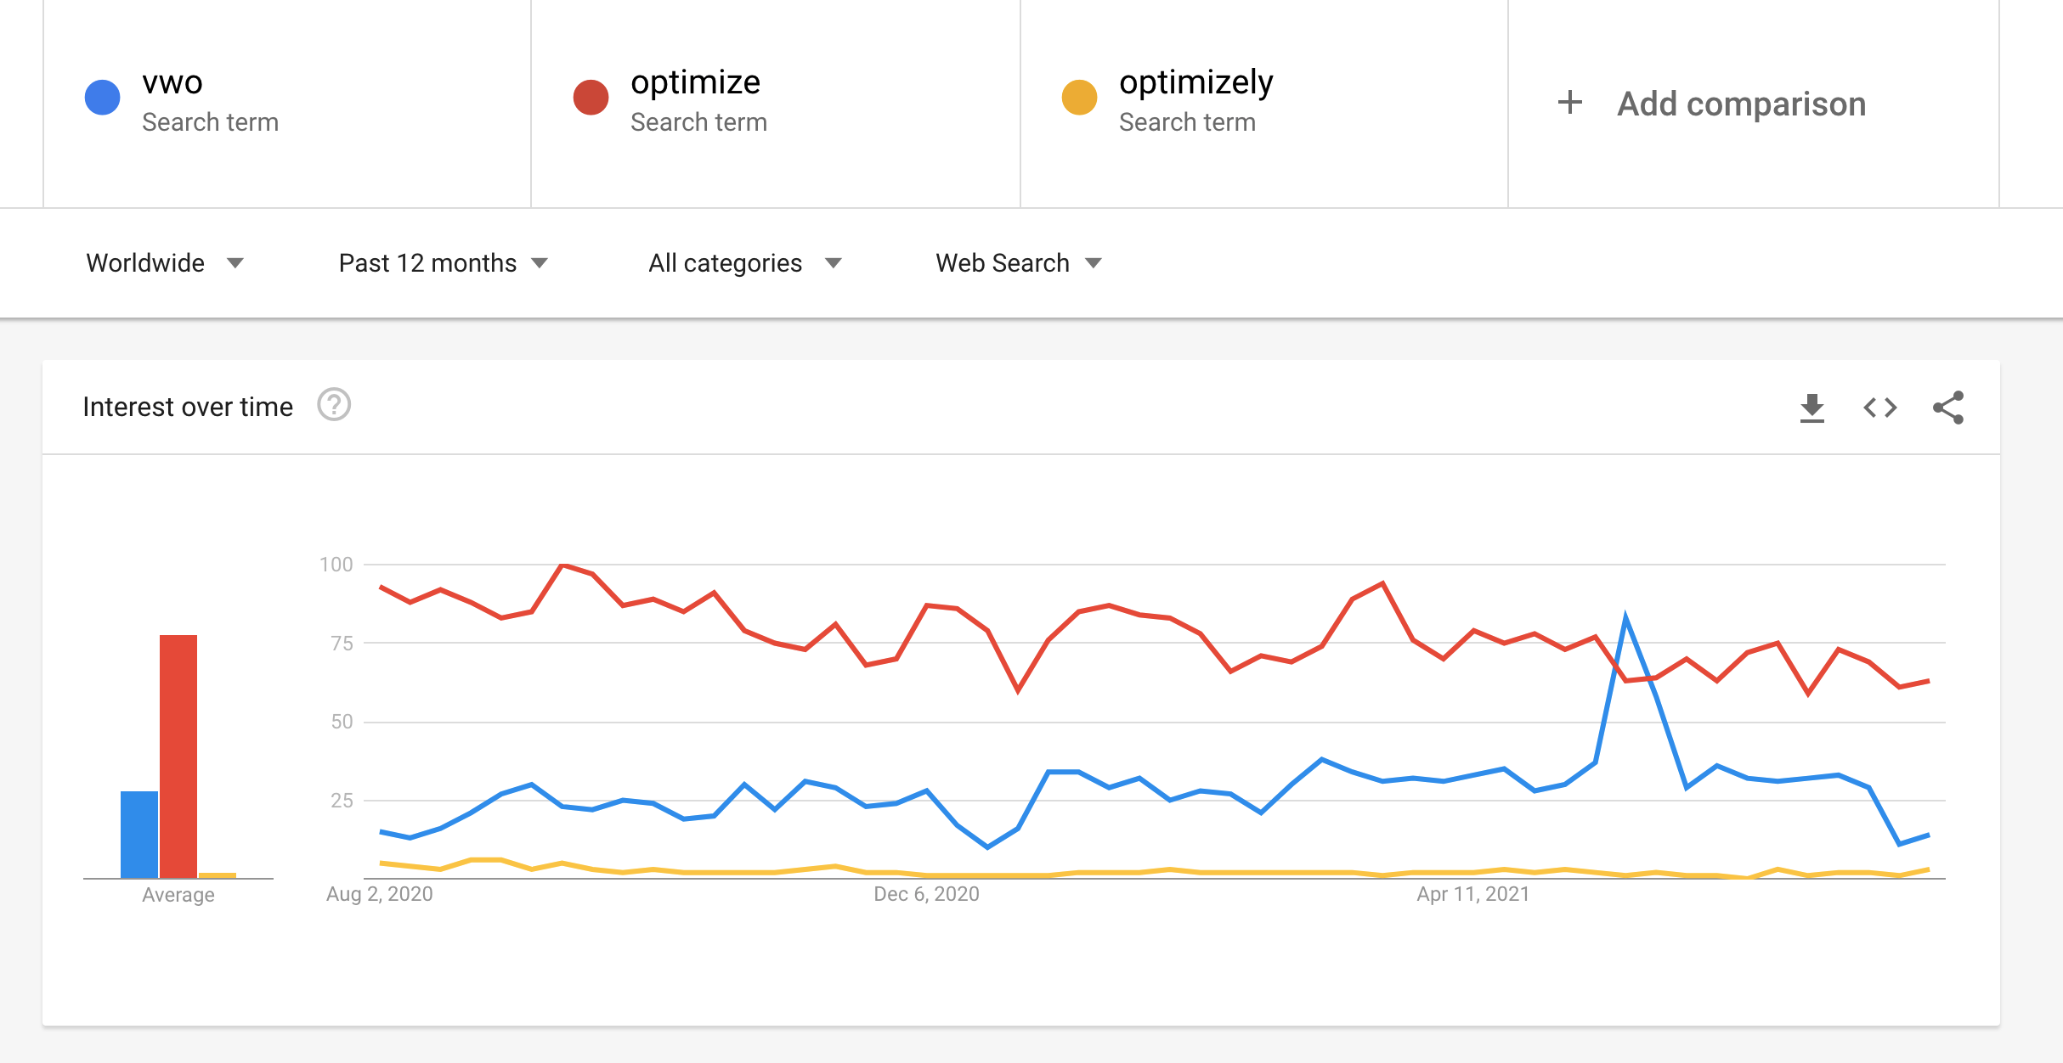
Compare
https://trends.google.com/trends/explore?geo=US&q=vwo,optimize,optimizely
https://vwo.com/compare/optimizely/
https://vwo.com/compare/google-optimize/

Slide 15


Demo
https://optimize.google.com/

Slide 16
Demo
GTM set tags and triggers
GA set goals
optimize to create an experience
optimize to create variants
optimize binds GA goals
Start the experience
View report
Deployment modification

Slide 17
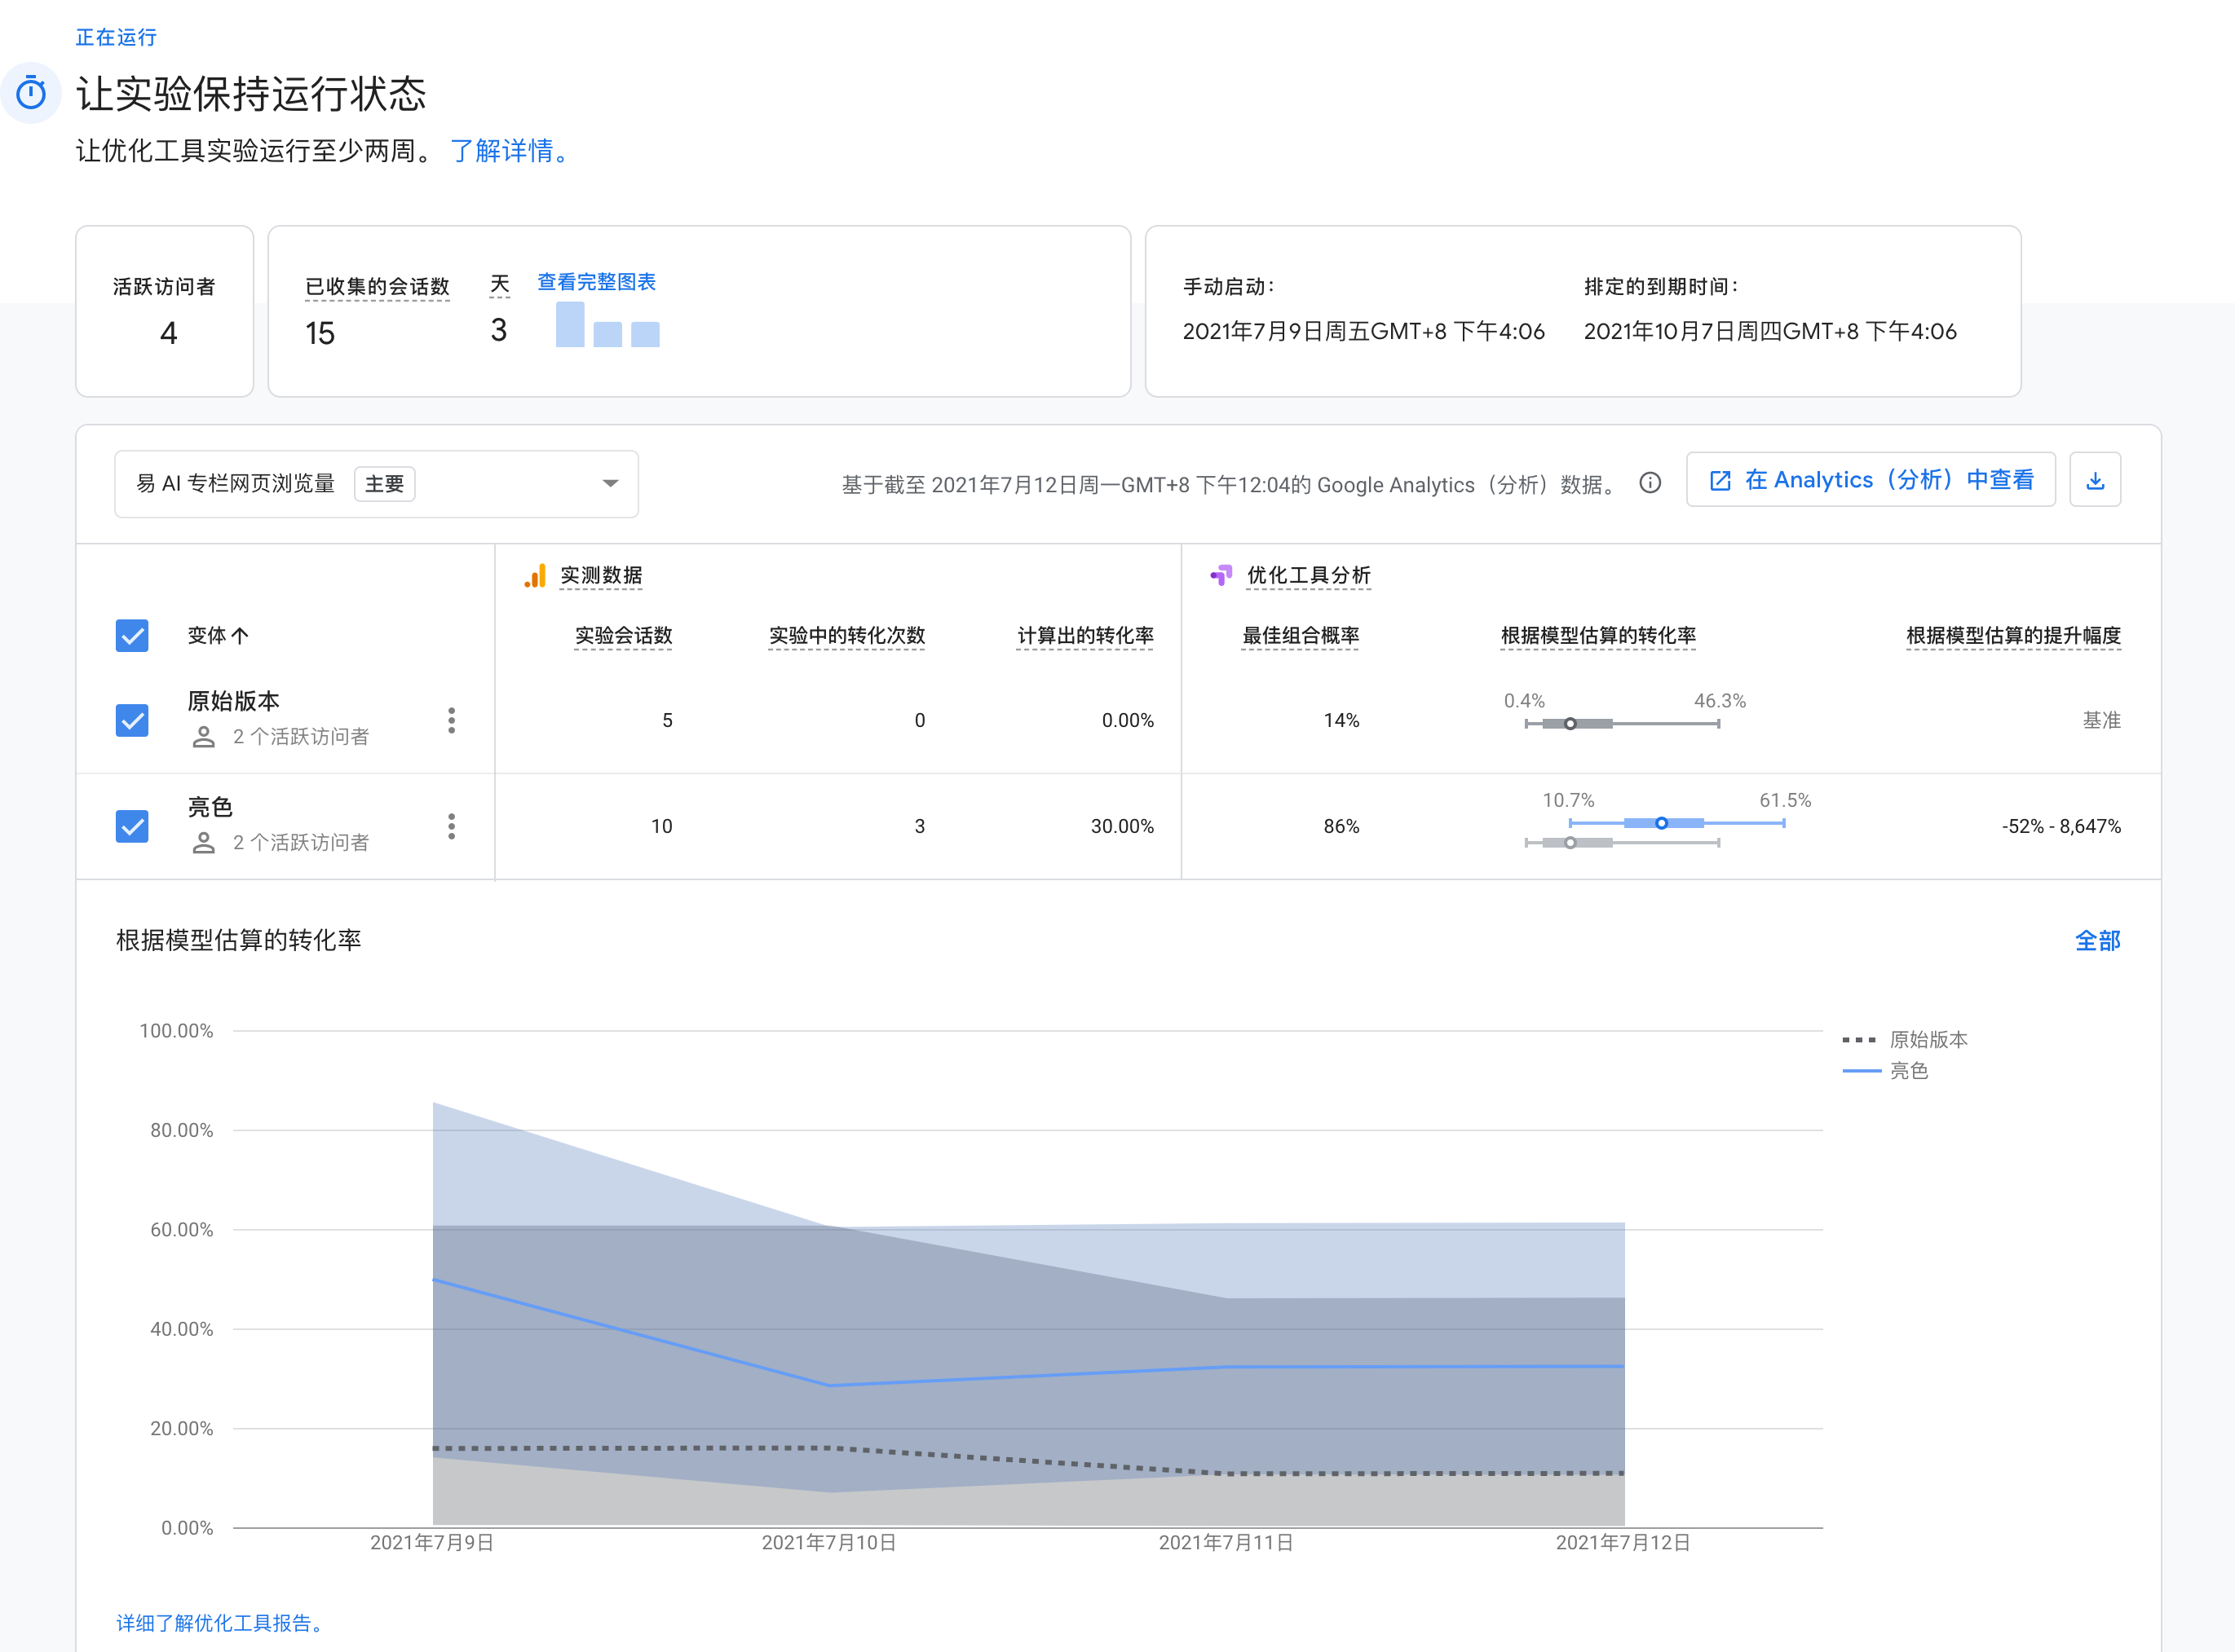
Demo

Slide 18
Key points
Fast forward in small steps and continuously optimize the website (agile thinking)
Data drives better decisions
AI helps automate the generation of different variants for experiments
The characteristics of A/B testing can be used to make temporary (temporal) requirements similar to banners
The focus of A/B testing is not on tools, but on reasonable assumptions and goals, and improvements based on data

Slide 19
Reference
https://en.wikipedia.org/wiki/A/B_testing
https://vwo.com/ab-testing-3/
https://wenku.baidu.com/view/d7f46172a8ea998fcc22bcd126fff705cc175c29.html?fixfr=zs%252Bg49dYPaMDe%252FQKjI%252BMtQ%253D%253D&fr=income5-search
https://wenku.baidu.com/view/14c50009aff8941ea76e58fafab069dc512247e5.html?fixfr=hGZ7lXgdvdCZRa8NyQRXxw%253D%253D&fr=income7-search
https://blog.csdn.net/zhuxiao5/article/details/106132477
https://vwo.com/tools/ab-test-duration-calculator/

